Slide 1

UNIT-5
MODALS

Slide 2
Exercise-5.1 Complete the text with must / mustn’t or have to / don’t have to. Tips for being a nurse
You have to wear a uniform and you
(1) have to/ must keep it always clean. You (2) be able to stand the sight of blood. You (3) be caring and friendly. You (4) be impatient or rude.
You (5) talk to relatives but sometimes it can help you and the patients. You
(6) prescribe medicine-that’s the doctor's job.

Slide 3


Exercise-5.2

Slide 6
5. I think that sign means we ________ enter the building. Look, there's a security guard too.
A) Won’t B) Mustn’t C) Have to D) Will
6. Lindsay watched the movie in French and ________ understand very much of it.
A) Didn’t have to B) Can’t C) Couldn’t D) Can

Slide 7
7. Before this year, I __________ move out of my parents' house because I did not have a job.
A) Couldn’t B) Cannot C) Should D) May not
8. My best friend said, " I _____ help you move next week.”
A) able to B) Be able to C) Will be able to D) Must be able to

Slide 14
21. Which modals do you use to express ability?
A. must/have to
B. should/shouldn't
C. can/be able to
D. can/must

Slide 15
22. Which modals do you use to give advice?
A. can/could
B. should/might
C. should/shouldn't
D. have to/must

Slide 16
23. Which modal do you use to express prohibition?
A. should
B. can
C. have to
D. can't
24.Find a similar sentence:
It is illegal for us to smoke here.
A. We shouldn't smoke here.
B. We can't smoke here.
C. We don't have to smoke here.
D. We have to smoke here.

Slide 17
25. The family can't decide where to go on vacation. They ____________ go to Los Angeles or they ____________ go to Hawaii.
A. could.... couldn't
B. May.... are able to
C. might...may
D. should... should

Slide 18
Exercise-5.3

Slide 19
1. But now that I have finished college and have a job, I realize that living at home _____ drive my parents and me crazy. (potentially)
a. might have
b. would
c. should
d. would have
e. should have

Slide 20
2. Unfortunately, it's not so easy to find to find an apartment in the city. Without an agent, you_____ not be able to find all the available listings. (possibility)
a. ought to
b. must
c. should
d. might
e. can

Slide 21
3. Before now, I couldn't sign a lease, but now I _____ because I am twenty-one.
a. able
b. can
c. can able
d. can do
e. sign

Slide 22
4. I asked my friends to help me move because I knew that I _____ fit all my possessions into my little car. (inability)
a. can't be able to
b. not able to
c. don't be able to
d. couldn't
e. couldn't be able to

Slide 23
5. He added, " I _____ help earlier in the morning than later in the afternoon." (preference)
a. would better
b. would like
c. would have
d. would rather
e. would

Slide 24
6. My father also offered to help me move. He __________ really eager to have me move out! (conclusion)
a. must have been
b. would
c. can have been
d. ought to have
e. has to be

Slide 25
7. Another friend told me that he ______ me move, but he never showed up.
a. would help
b. would have helped
c. will help
d. would helped
e. will have helped

Slide 26
8. I was using my pencil a minute ago .It ________be here somewhere!
a. can
b. could
c. must
d. would

Slide 27
9. My parents are happy for me, but warned, "You _____ spend all your money each month. Save a little extra money for unexpected emergencies."
a. should
b. ought not to
c. must not have
d. aren't able to
e. would not

Slide 28
10. Which sign are you more likely to see at an airport: Bags ____ not be left unattended.
a. can
b. must
c. may
d. are

Slide 29
11. Whose is this bag? - I don’t know, but it _____ belong to Yuta.
a. could
b. may
c. should
d. would

Slide 30
12. I _____ on the wood floor, but it was too hard, so I bought a sofa-bed. (option not taken)
a. could sleep
b. couldn't sleep
c. could have slept
d. could of slept
e. couldn't have slept

Slide 31
13. It _____ about a year until I am able to completely furnish my apartment. (prediction)
a. must take
b. will take
c. would take
d. will have taken
e. must have taken

Slide 32
14. By this time next year, I _____ a lot about living independently. (time-relative prediction)
a. must learn
b. will learn
c. would learn
d. will have learned
e. must have learned

Slide 33
15. What do you want to do? - Well, we _______ have a picnic, but it looks like rain.
a. can
b. could
c. should
d. would

Slide 34
Exercise-5.4
They _________ call tomorrow. I hope so!
A may
B shall
C would
D should
2.It’s the best movie I have ever seen. You ______ see it.
A may
B must
C might
D should

Slide 44
Exercise-5.5-
ACTIVITY

Slide 45
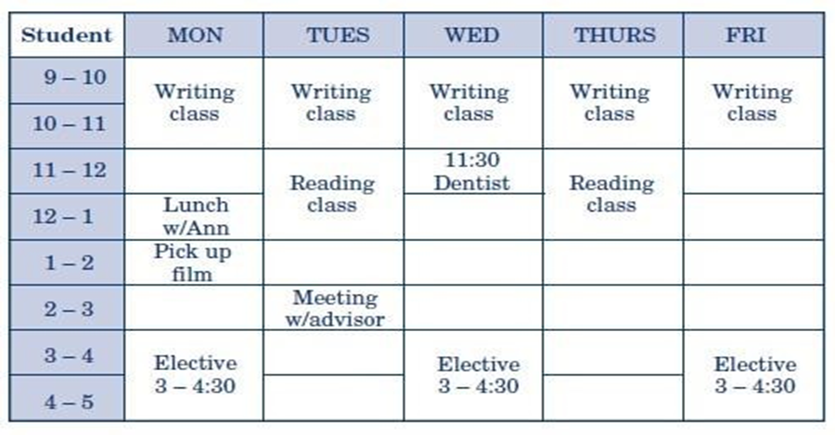
Student A is calling to make an appointment. Student B is a receptionist in a doctor’s office. Complete the conversation with the best use of modals.
Sample conversation:
Student A: Hello. I need to make an appointment with the doctor.
Student B: Would you be available on Monday at 3:30?
Student A:

Slide 46
When you get to practice against the best, it brings the best out of you……!
Thank You

